Slide 1
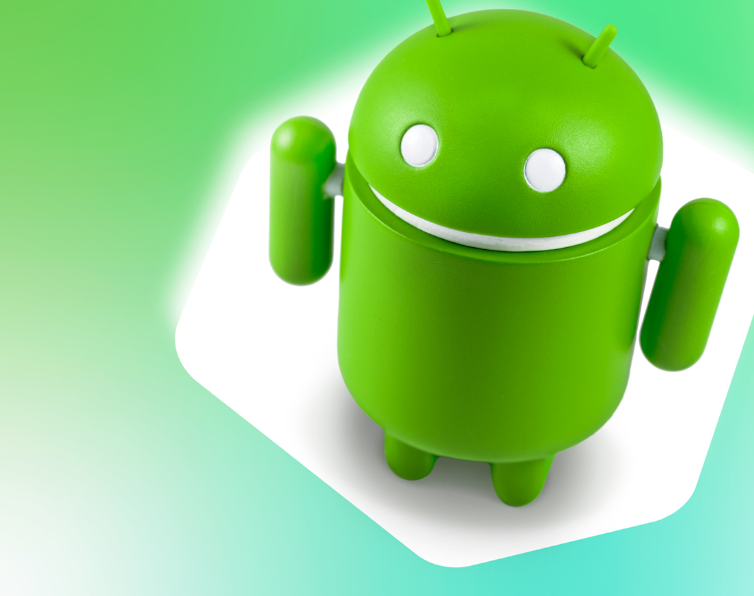
ANDROID APP DEVELOPMENT
THE SAFE CAB APP

Slide 2

TEAM MEMBERS
1.Sarvendra Kumar Singh(Team Lead)
2.Sanal Mishra
3.Prabhat Kumar Singh
Mr. Vinay Agarwal(Project Mentor)

Slide 3

WHAT IS THIS PROJECT?
Safe cab android project is one such project which will responsible to provide taxis during your journey time. When you are in need to hire taxis for travelling purpose use this app and based on the information received from this app, taxi driver will able to get your location and available to provide you the service. This app is really helpful in metro city where there is more traffic problems and you have to wait in line to take token from taxi stand. This system uses the feature of GPS using which the taxi driver will locate you using its google map and with the help of GPS compass.

Slide 4


OVERVIEW OF PROJECT:
The main objective of our project is to make a safe cab driving android application, due to which the passenger will not wait for any travelling source to reach their destination. this app is mainly developed for the rural areas as there is no such facility in the rural areas and they have to wait for hours to get another bus as their are very limited number of buses travelling in the rural areas.so this app will help them to reach to their destination as as soon as possible and also into their budget.

Slide 5
Hardware And Software Requirements:
4GB or higher RAM
Minimum i3 Processor
A back up disk/drive
Android Studio
Java IDE
PHP Editor
SQL Editor
Android Emulater

Slide 6

Android Studio:
Android Studio is the official Integrated Development Environment (IDE) for Android app development, based on IntelliJ IDEA . On top of IntelliJ's powerful code editor and developer tools, Android Studio offers even more features that enhance your productivity when building Android apps, such as:
A flexible Gradle-based build system
A fast and feature-rich emulator
A unified environment where you can develop for all Android devices

Slide 7
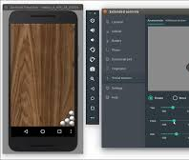
Android Emulator
The Android Emulator simulates Android devices on your computer so that you can test your application on a variety of devices and Android API levels without needing to have each physical device. The emulator provides almost all of the capabilities of a real Android device. You can simulate incoming phone calls and text messages, specify the location of the device, simulate different network speeds, simulate rotation and other hardware sensors, access the Google Play Store, and much more. Testing your app on the emulator is in some ways faster and easier than doing so on a physical device. For example, you can transfer data faster to the emulator than to a device connected over USB. The emulator comes with predefined configurations for various Android phone, tablet, Wear OS, and Android TV devices.

Slide 8
Structure Of An Android Application
An android application can be formed using two files namely .xml file which is used for providing the structure to our app and the .java file which is used to add the functionalities to our application.

Slide 9

A basic introduction to XML and markup languages
XML stands for Extensible Markup Language, which gives us a clue to what it does. A markup language is slightly different from a programming language. Whereas a programming language (C#, C++, Java, Kotlin, Python, BASIC) will allow you to define behaviors, interactions, and conditions; a markup language is used more to describe data, and in this case, layouts. Programming languages create dynamic interactions, whereas markup languages generally handle things like static user interfaces.

Slide 10

Introduction To Java
When it’s time to develop Android apps, Jave remains one of the two official options. This means that it has a lot of support from Google. Most non-game apps were probably built with either Java or Kotlin. The number one way to develop Android apps, is to go ahead and download Android Studio. This is a piece of software called an IDE, or Integrated Development Environment. It will come packaged with the Android SDK (a set of tools to facilitate Android development specifically) and this will give you everything you need in one place to get up and running.

Slide 11
Kotlin vs Java for Android
KOTLIN is a cross platform, statically types, general purpose programming language with type inference. KOTLIN is designed to interoperate fully with java but type inference allows its syntax to be more concise.KOTLIN is sponsored by JetBrains and Google through the Kotlin Foundation.
JAVA is an Object Oriented Programming Language developed by JAMES GOSLING and colleagues at SUN MICRO SYSTEMS in 1991.The language was initially called OAK. It was developed as a full fledged programming language in which one can accomplish the same sorts of tasks and solve the similar problems that one can do in other programming languages such as BASIC,C++ etc. Despite all the differences between the two languages, Java and Kotlin are 100% interoperable. You can call Kotlin code from Java, and you can call Java code from Kotlin. So it’s possible to have Kotlin and Java classes side-by-side within the same project, and everything will still compile.

Slide 12

Fire Base
Firebase is Google's mobile platform that helps you quickly develop highquality apps and grow your business. Firebase gives you functionality like analytics, databases, messaging and crash reporting so you can move quickly and focus on your users. It builds app fast , without managing infrastructure. Firebase is built on Google infrastructure and scales automatically, for even the largest apps.Firebase products work great individually but share data and insights, so they work even better together. Firebase improves app quality. It gives crashlytics , performance monitoring , test lab, app distribution , Authentication, cloud functions, hosting, cloud storage,google analytics ,remote configuration, realtime database and so on.

Slide 13
APIs
The API used are : Google Maps
Maps SDK Android
Google Maps is a web mapping service developed by Google. It offers satellite imagery, aerial photography, street maps, 360° interactive panoramic views of streets (Street View), realtime traffic conditions, and route planning for traveling by foot, car, bicycle and air (in beta), or public transportation. Google Maps' satellite view is a "up- down" or bird's-eye view; most of the high-resolution imagery of cities is aerial photography . Google Maps used a variant of the Mercator projection, and therefore could not accurately show areas around the poles.

Slide 14
MODULES AND FUCTIONALITIES
The app is based on typically two modules namely:
1. Drivers Module and
2. Customers Module
Each Module supports same or different functionalities which we will see in details below.
Functionalities used in studio are:
1. Main Activity
2. Map Activity
3. Login Activity
4. On App Crash
5. PayPal
6. History Activity
Map and Login Activity are further split in both the modules

Slide 15


1. Main Activity:
One activity in an app is specified as the main activity, which is the first screen to appear when the user launches the app. Each activity can then start another activity in order to perform different actions. An app usually consists of multiple screens that are loosely bound to each other. Each screen is an activity. Typically, one activity in an app is specified as the "main" activity which is presented to the user when the app is launched. The main activity can then start other activities to perform different actions. This Activity offers you option to chose whether you are a Driver or Customer. Based on your Selection, the activity directs you to respective module of the app.

Slide 16

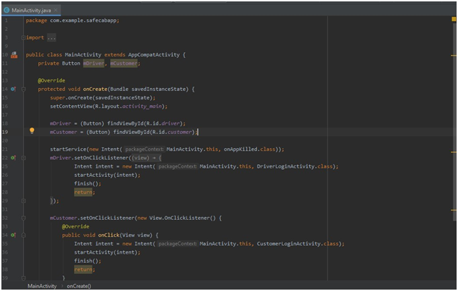
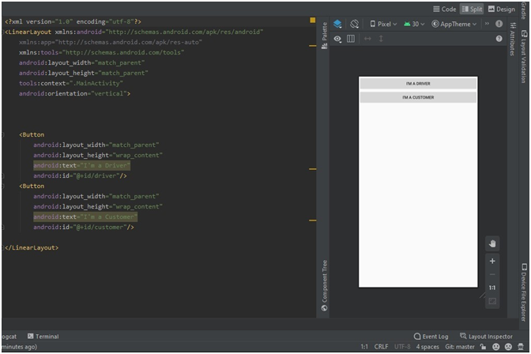
Related Screenshots

Slide 17

2. Login Activity:
We have module division starting from this activity. The activity shows similar kind of interface in both the modules but are seperately authorised for authentication from firebase. We have build same activity for both the modules with different IDs and Authentication, which takes them to next activity with features depending on the requiremnt of respective modules.
The Code gives a glimpse of the features/functions which are same in both the modules ( ofcourse with different IDs and access). Above shown picture shows Customer Module’s Login Activity which is same as Driver’s one.

Slide 18
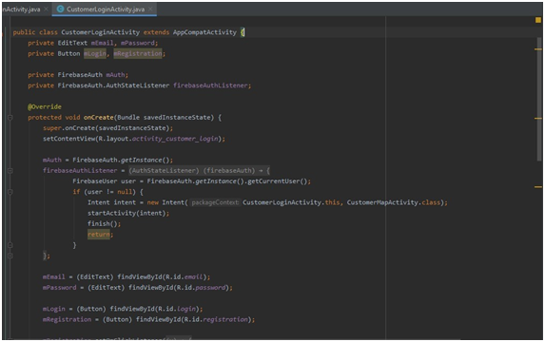
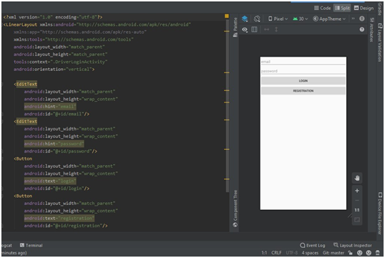
Related Screenshots

Slide 19
3. Map Activity:
This activity takes us to a page where we can check our location and further access other all other activities/functions. This activity can only be accessed if our Firebase Client permits us for authentication. This activity is most important in our app and it links to Real-Time Database of our Firebase Project.

Slide 20
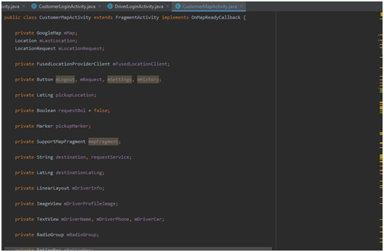
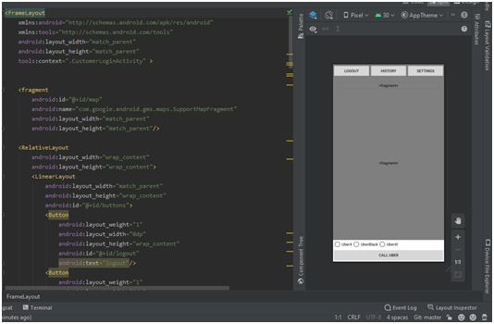
Related Screenshots

Slide 21
4. On Crash Activity:
This activity comes into effect the moment we are authorised for any one module of our app. The activity prevents our data from being lost when the app is killed/crashed. When the App crashes then it redirects the customer to the login page or in the main activity page . The most important reason [apps crash] is the responsiveness and your app hanging when you're trying to get some data, or you have submitted something and you're waiting for a response.

Slide 22
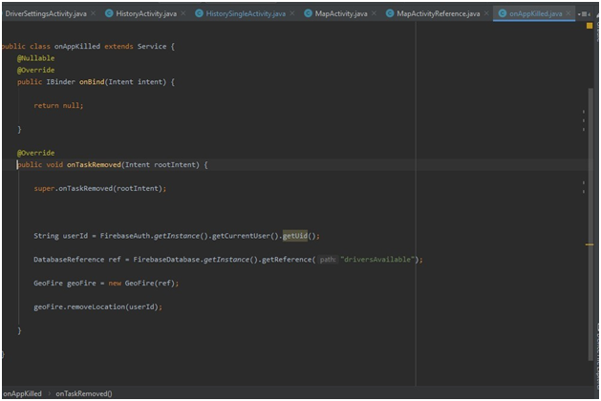
Realated Screenshots

Slide 23
5. History Activity:
This activity lists all previous rides to the customer and driver which are completed. This activity also refers to a function of payment from which the customer can Pay his ride fair which he has completed previously through PayPal Gateway System. We have an activity named HistoryActivity which further refers to 3 different sets of files HistoryAdapter, HistoryObject and HistoryViewHolder namely stored in a folder accessed through reference of HistoryActivity file.

Slide 24
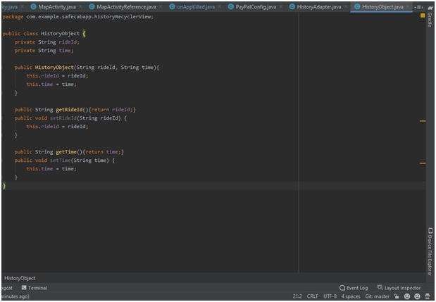
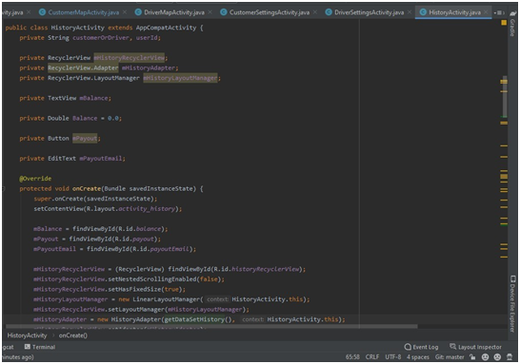
Related Screenshots

Slide 25

6. Settings Activity:
This activity is present in both the modules and it helps in setting up profiles of both driver and customer. The data entered through this activity is stored in our firebase database.

Slide 26
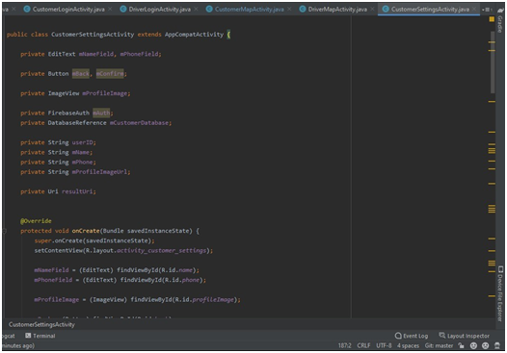
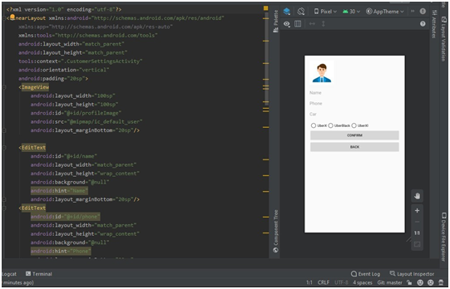
Related Screenshots

Slide 27
7. PayPal Activity:
This activity links the customer module to make his online payment of fair through the app itself with help of PayPal.

Slide 28

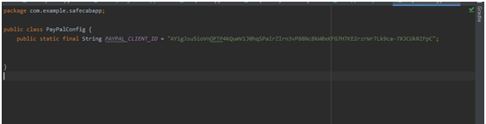
Related Screenshots

Slide 29

FIREBASE PROJECT
Firebase Authentication provides backend services, easy-to-use SDKs, and ready-made UI libraries to authenticate users to your app. It supports authentication using passwords,phone numbers, popular federated identity providers like Google, Facebook and Twitter, and more.Firebase Authentication integrates tightly with other Firebase services, and it leverages industry standards like OAuth 2.0 and OpenID Connect, so it can be easily integrated with your custom backend. The users of our app are authenticated through Firebase authentication

Slide 30
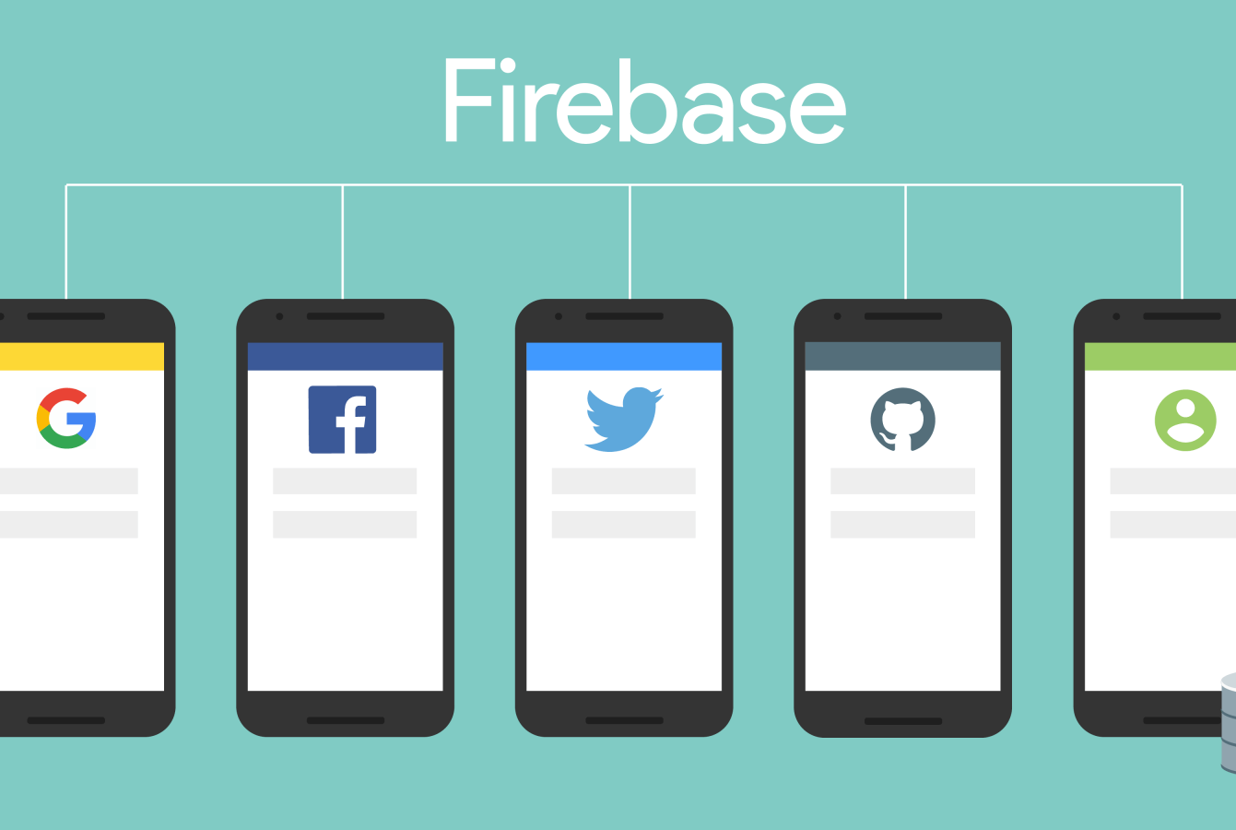
HOW IT WORKS?

Slide 31
TYPES OF FIREBASE AUTHENTICATION
FirebaseUI Auth
Drop-in authentication solution
Firebase SDK Authentication
Email and password based authentication
Federated identity provider integration
Phone number authentication
Custom auth system integration
Anonymous auth

Slide 32
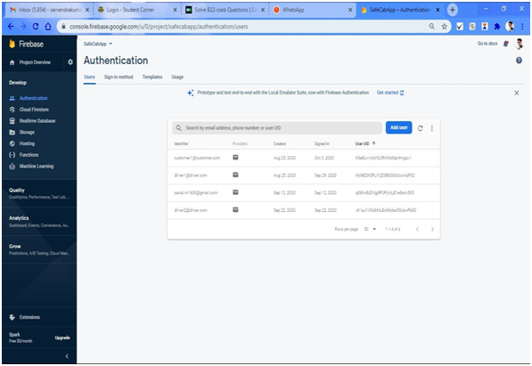
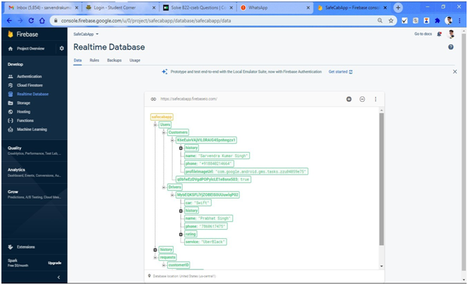
Related Screenshots

Slide 33
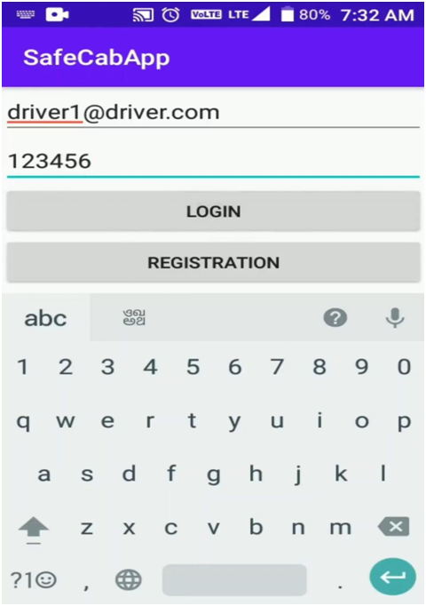
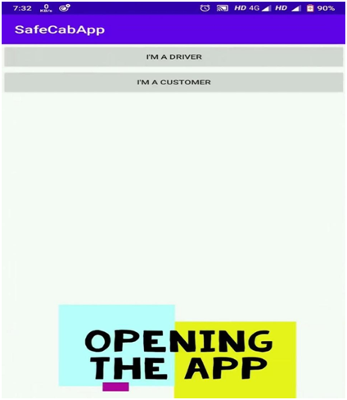
Final Implemented Screenshots
1.Main Activity
2.Driver Login Activity.

Slide 34
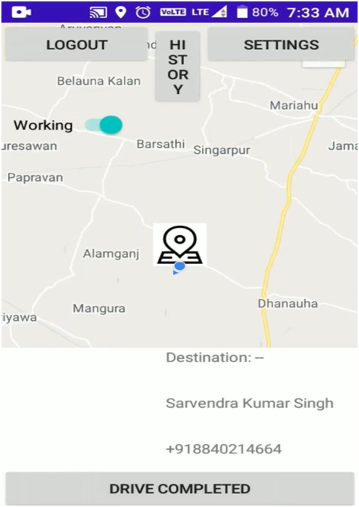
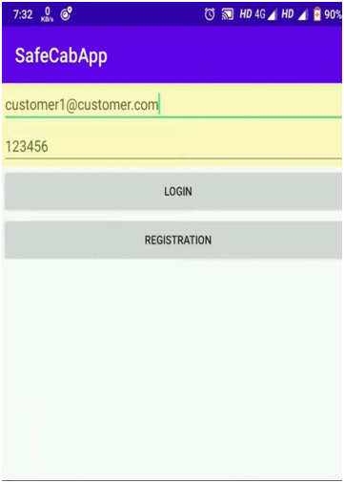
Continued..
1.History Activity
2.Customer Login Activity

Slide 35
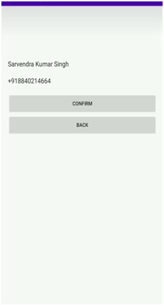
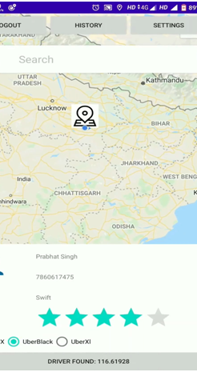
Continued..
History Activity
Customer Settings

Slide 36
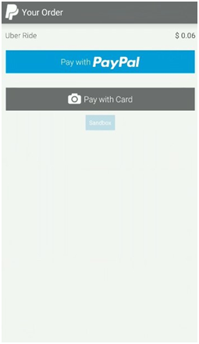
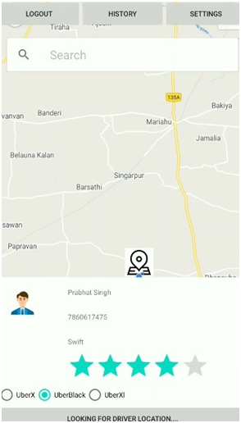
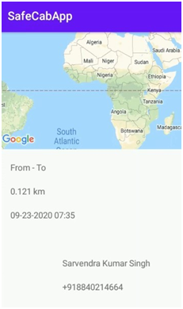
Some more Screenshots of our test run:

Slide 37
References
This project is about the designing of online cab booking system. Present system of cab booking is having some shortcomings on which we have tried to work on that to eliminate the disadvantages.
We use java framework for backend applications and android studio for app development. ht tps://books.google.co.in/
Safe cabapp automation using realtime adaptive scheduling. Realtime tracking management system using GPS,GPRS.
We preferred ht tps://developers.google.com/maps/documentation/ios-sdk for Google Map APIs. https://developers.google.com/places for selection of particular place.
www.google.com
developer.android.com
Firebase.google.com
codelabs.developers.google.com
Rob Percival, Nick Walter, Codestars by Rob Percival on Udemy.

Slide 38


